Slide 1

I Exist

Slide 2
I Exist
This app is not created for the faint of heart!
The thrill seekers and horror enthusiasts will finally be able to merge their own world to meet the entities that our eyes cannot see.
Simply download the app via any Android or iOS gamestore, turn on your camera and location capabilities, load and get ready to experience horror in your own environment!
The game will allow you to capture entities anywhere you are. Some will be unlocked and readily available, others will be locked and only show up once unlocked using your gathered reward system points.
Be careful how you spend your points though! There are two reward systems to gather. Some can only be used to unlock entities, and others will be saved for those who want to order a real-life figurine of their captured entity at a discounted cost with points used!

Slide 3
Gameplay
Once loaded, you will choose the options of loading the game, or browsing through your inventory.
If loading to play, your camera will turn on and you will see your environment. Scan it!
- You will either:
- See an entity in your surroundings.
- Hear eerie music alerting you to an entity in your surroundings. At this point, start moving around and the eerie sounds will get stronger or weaker depending on your closeness.
Once you see the entity, you will have three options. Option One is to press the middle left button to get the entities’ attention. Option Two is to press the bottom left button as quickly and as many times as possible to capture the entity. Option Three is only to be pressed if you want to grab more of the entities’ attention.
But be careful! If unsuccessful in the capture, the entity will screech and pass through you, causing you loss of points on the reward system

Slide 4
Gameplay continued…
If loading not to play, you have the option of checking out your inventory, which will include several subcategories.
Common Entities
Common entities can be found anywhere in the world once the app is loaded. They are fictional and all unlocked, with a riddle as a clue as to where they are most likely to be found and the set of functions to best capture them. They provide the user rewards once captured and have a quick fictional history the user can read.
Rare Entities
Rare entities can be found anywhere in the environment once the app is loaded. They are fictional and all unlocked, however the accompanying riddles are harder to solve but still provide clues as how to capture them once encountered. Also, not only are they more aggressive but their respawn times are longer which is why they provide greater reward points once captured. Once captured, a short history is provided to the user to read.
Unique
Unique entities are unlocked and locked fictional characters. They are provided with a clue, are harder to capture due to no clues as to how the user should react if a sighting happens, and have a longer respawn rate than Rare entities, as well as greater rewards. The locked Uniques are only available if the user chooses to use some of their reward points to hunt them in their environment. Every unique entity, once captured, will also provide the user with a fictional background of their story.

Slide 5
Gameplay continued…
Legendary
Legendary entities are locked, non-fictional and can only be found at the place that the hauntings happen. Users can unlock these at a greater expense from their reward system. Due to location differences, these would be different for each user dependant on their original GPS location. Once caught, the user will be provided with a unique serial number that they can use to claim their real-life figurine of the entity. The respawn rate would also differ for users that have travelled to the area as opposed to the users already living in the area.
Special Events
Special Event entities will be scheduled randomly throughout the year and will include students from colleges that require internship hours for their course to build sets, etc. The events themselves will last a week and require an admittance fee (the proceeds going to a chosen charity). The users will be provided entrance into the built set (which would include replicas of certain historical sites) to search for entities within. Usually the entities would be a part of a fictional or non-fictional family tragedy. If the user is able to capture all entities required within, their reward system would update to reflect their progress.

Slide 6
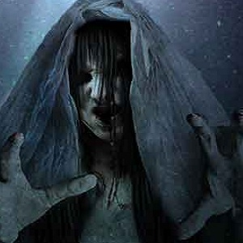
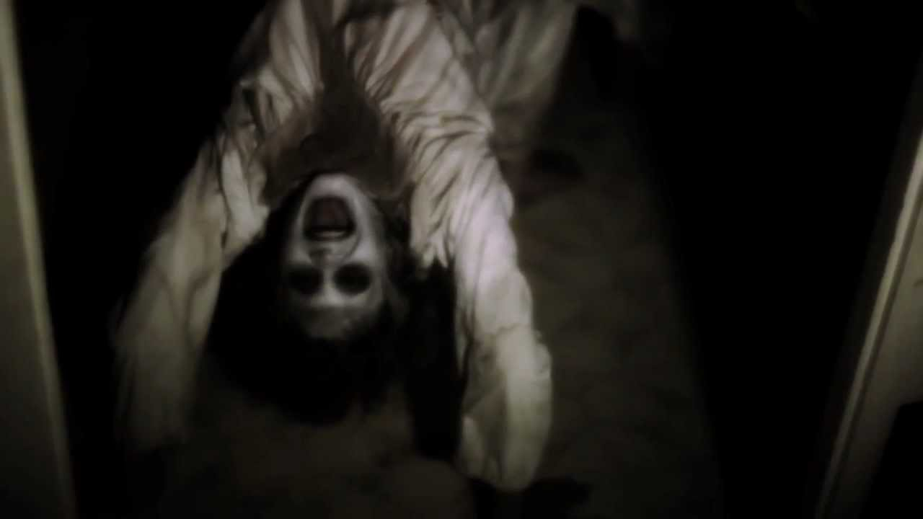
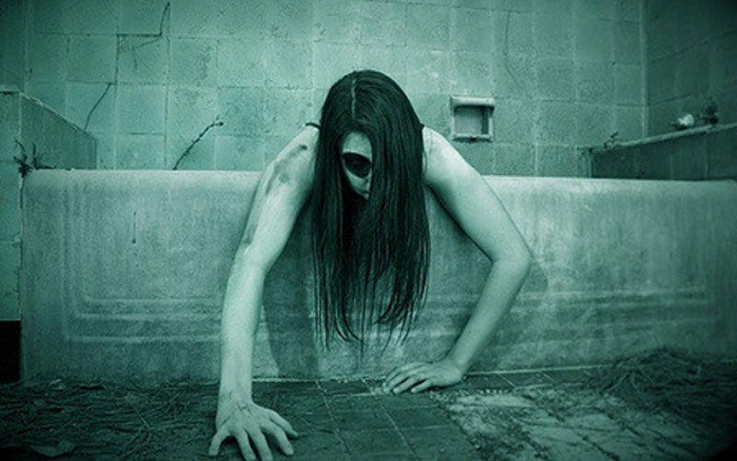
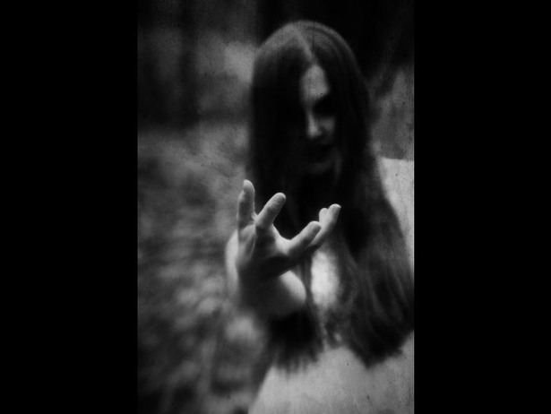
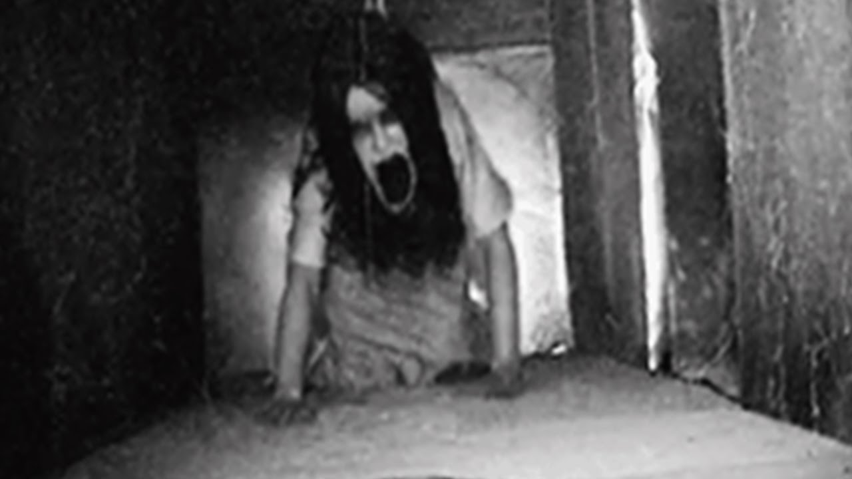
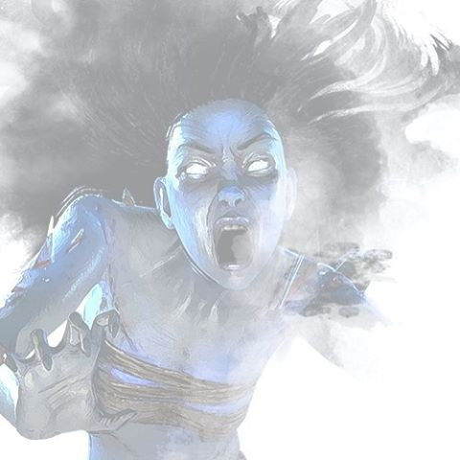

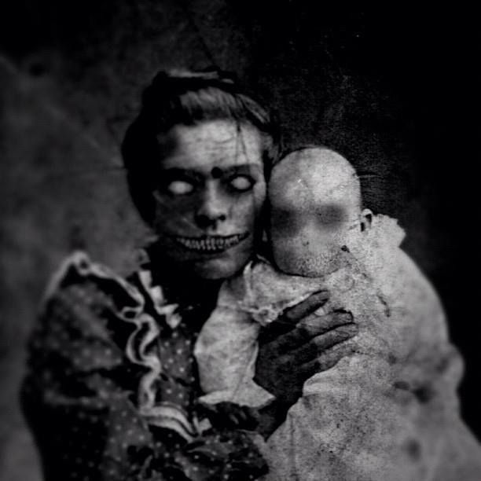
Some Entities you will encounter!

Slide 7
The Best Part!
Who says Hallowe’en only needs to come once a year!?
I Exist is a gaming app you can take anywhere with you and load any time you feel safe enough to encounter a fright!
The Special Events will not only give others in your community to practice building for their internships, but will also give you an opportunity to create a special bond with other enthusiasts, all the while contributing to a charitable cause!
The most awesome thing? Besides being able to converge your world with the other in your own reality, the two reward systems will not only allow you to unlock new entities to exist in your environment, but also the ability to purchase your own, hand-made figurine with a unique serial number to SHOW OFF!

Slide 8
Happy Haunting!

